Slide 1
Exam 1
David Quigley
CSCI 5622
2021 Fall

Slide 2
Tuesday

Slide 3
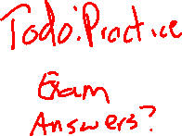
Course Logistics
Project Pitch Feedback – Did you get your Projects to Review?
Exam 1 – October 21st
Just released a “Practice Exam” that should show off the formatting, etc.
Problem Set 3 – Due November 2

Slide 4
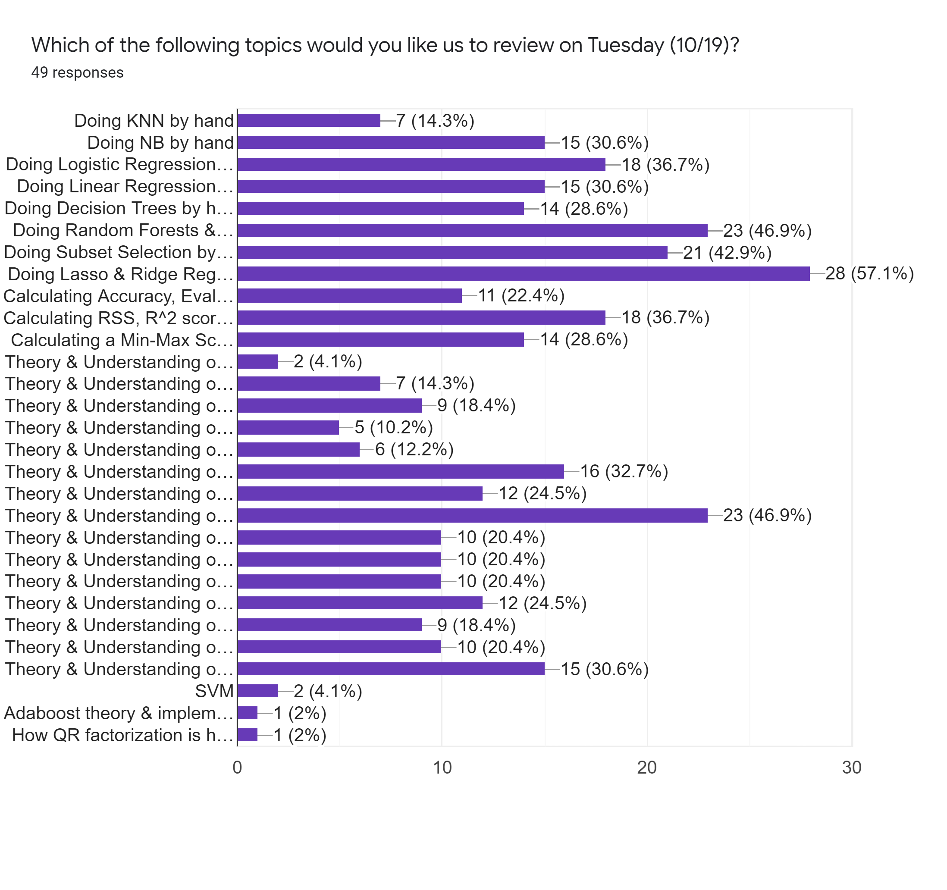

Exam 1 Review Poll
Lasso & Ridge Regression

Slide 5
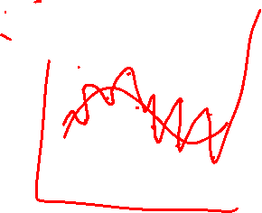
Minimizing RSS – With Penalty
RSS = ||Y – Xw||²
ŵ = argmin_{w} (||Y – Xw||²)
Add a penalty term
ŵ = argmin_{w} (||Y – Xw||² + λ * ∑ _{k=1➔D} penalty(w_{k}))
How do we choose our penalty function?
How do we choose our tuning parameter λ?

Slide 6
Exam 1 Review Poll
Interlude: RSS

Slide 7
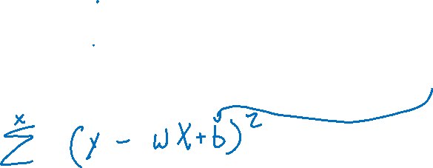
Practice Exam 1 Question
Consider a 1D Linear Regression problem, with the following data points:
We set our initial weight w₁ to 2.0 and our bias term w₀ to 1.0. What is the initial Residual Sum of Squares (RSS)?
x₁ | 1.0 | 2.0 | 3.0 | 4.0 | 5.0
y | 1.0 | 2.0 | 4.0 | 8.0 | 11.0

Slide 8

Practice Exam 1 Question
Consider a 1D Linear Regression problem, with the following data points:
We set our initial weight w₁ to 2.0 and our bias term w₀ to 1.0. What is the initial Residual Sum of Squares (RSS)?
RSS = ||Y - Xw||^2
(1 - 3)^2 + (2 - 5)^2 + (4 - 7)^2 + (8 - 9)^2 + (11 - 11)^2
4 + 9 + 9 + 1 + 0
23
x₁ | 1.0 | 2.0 | 3.0 | 4.0 | 5.0
y | 1.0 | 2.0 | 4.0 | 8.0 | 11.0

Slide 9
Minimizing RSS – With Penalty
RSS = ||Y – Xw||²
ŵ = argmin_{w} (||Y – Xw||²)
Add a penalty term
ŵ = argmin_{w} (||Y – Xw||² + λ * ∑ _{k=1➔D} penalty(w_{k}))
How do we choose our penalty function?
How do we choose our tuning parameter λ?

Slide 10
Choosing Penalty Function
λ * ∑ _{k=1➔D} w²_{k}
The same penalty we used in Logistic Regression
L2 Norm (related to Euclidian distance from origin)
Ridge Regression

Slide 11
Choosing Penalty Function
λ * ∑ _{k=1➔D} |w_{k}|
L1 Norm (Manhattan distance from origin)
Lasso Regression

Slide 12
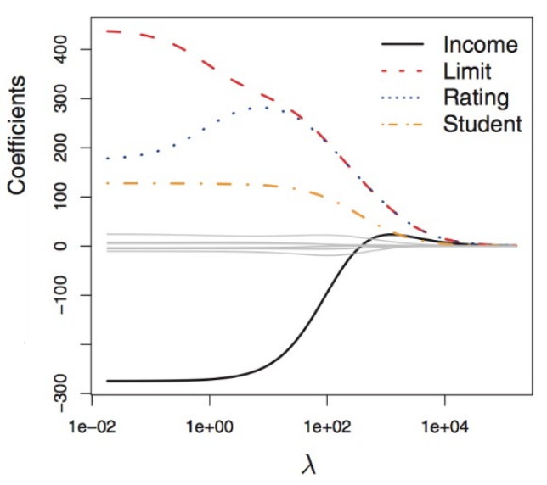
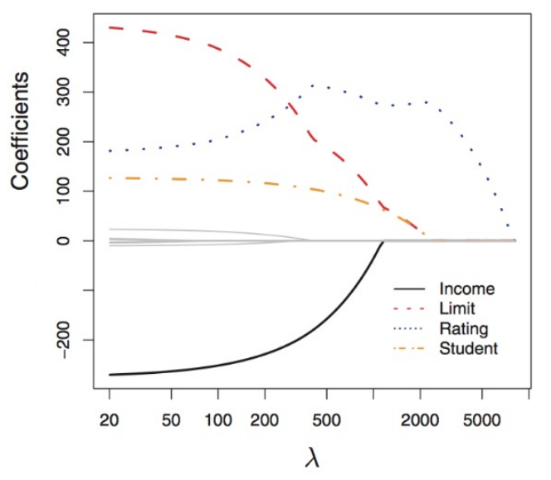

Model Behavior – Ridge vs. Lasso
Ridge Regression
- uniform converge
Lasso Regression
- different convergence
- collapses at 0

Slide 13
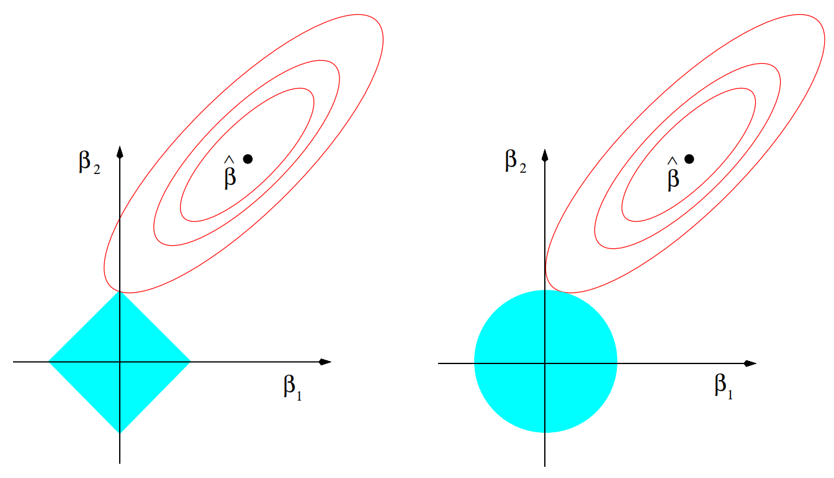
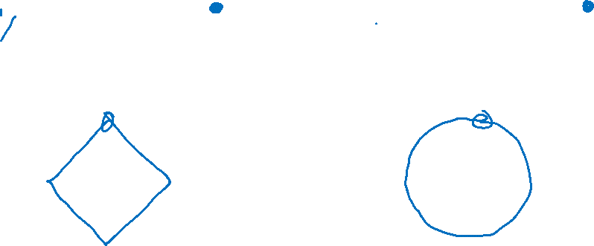
Understanding Model Behavior
Lasso Regression
In the 2D Case…
|w₁| + |w₂| <= s
Ridge Regression
In the 2D Case…
w²₁+ w²₂ <= s
Lasso Regression
min_{w}(||Y–Xw||²) such that
∑ _{k=1➔D}w²_{k} <= s (Ridge)
Ridge Regression
min_{w}(||Y–Xw||²) such that
∑ _{k=1➔D}|w_{k}| <= s (Lasso)

Slide 14
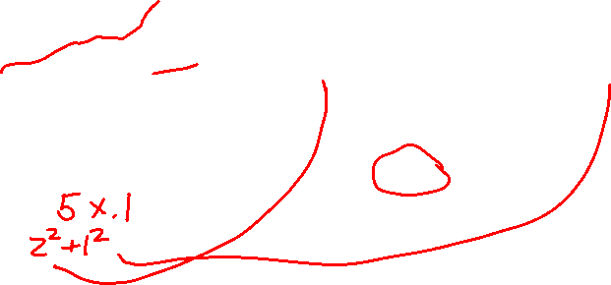
Practice Exam 1 (Potential Lasso / Ridge Add-On
Consider a 1D Linear Regression problem, with the following data points:
We set our initial weight w₁ to 2.0 and our bias term w₀ to 1.0. What is the initial Residual Sum of Squares (RSS)?
What is the penalized RSS for (Lasso / Ridge) regression with a λ of 0.1?
x₁ | 1.0 | 2.0 | 3.0 | 4.0 | 5.0
y | 1.0 | 2.0 | 4.0 | 8.0 | 11.0

Slide 15
Practice Exam 1 (Potential Lasso / Ridge Add-On
Consider a 1D Linear Regression problem, with the following data points:
We set our initial weight w₁ to 2.0 and our bias term w₀ to 1.0. What is the initial Residual Sum of Squares (RSS)?
What is the penalized RSS for (Lasso / Ridge) regression with a λ of 0.1?
This answer builds on your answer to the above question – we would give credit based on how you calculate your answer with an incorrect answer to the above question.
x₁ | 1.0 | 2.0 | 3.0 | 4.0 | 5.0
y | 1.0 | 2.0 | 4.0 | 8.0 | 11.0

Slide 16
Exam 1 Review Poll
Ensemble Methods

Slide 17
Ensemble Methods– Random Forests
TRAINING
For M iterations:
Select N’ points with replacement
Train a decision tree:
For each split:
Choose F features to split on:
Choose your best split from them
Hang on to that decision tree
TESTING
For each test point:
Ask all the decision trees what decision to make
Accept Y

Slide 18
Ensemble Methods– Random Forests
TRAINING
For M iterations:
Select N’ points with replacement
Train a decision tree:
For each split:
Choose F features to split on:
Choose your best split from them
Hang on to that decision tree
TESTING
For each test point:
Ask all the decision trees what decision to make
Accept Y
Bagging
Random Feature
Selection

Slide 19

Ensemble Methods– Random Forests
TRAINING
For M iterations:
Select N’ points with replacement
Train a decision tree:
For each split:
Choose F features to split on:
Choose your best split from them
Hang on to that decision tree
TESTING
For each test point:
Ask all the decision trees what decision to make
Accept Y
Bagging
Random Feature
Selection

Slide 20
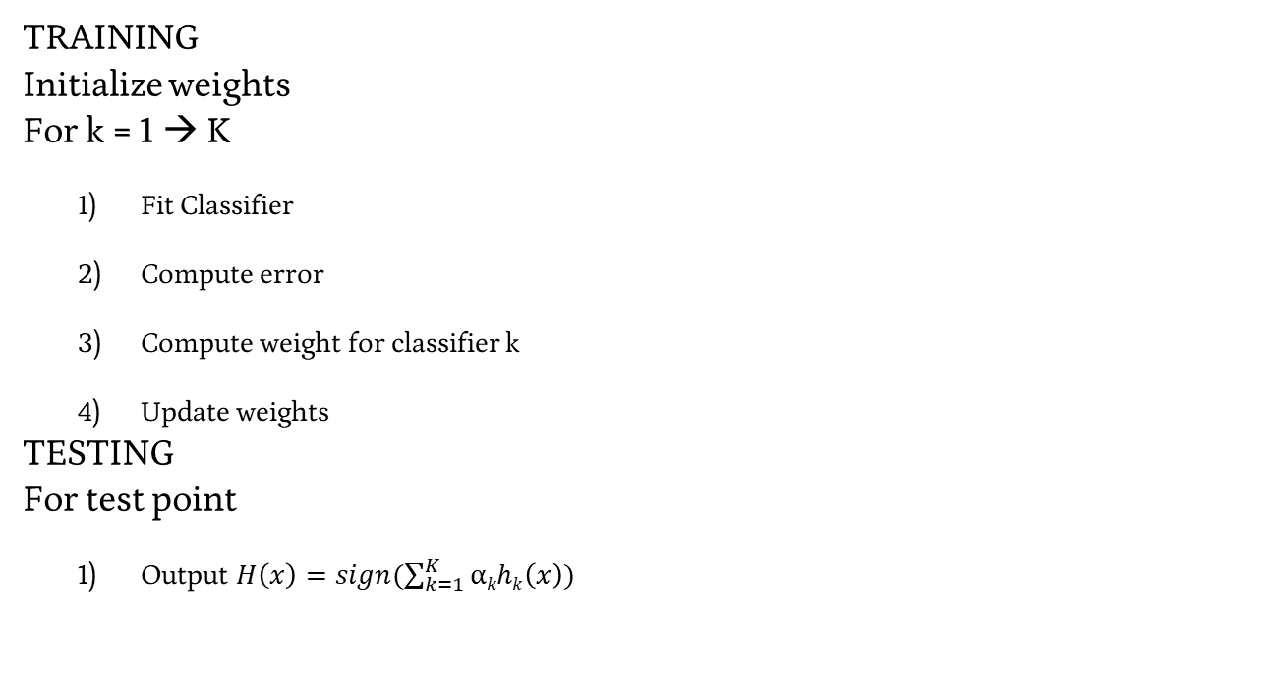
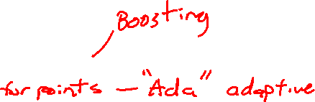
Adaboost in practice
TRAINING
Initialize weights
For k = 1 → K
Fit Classifier
Compute error
Compute weight for classifier k
Update weights
TESTING
For test point
Output $H\left(x\right)=sign(\sum_{k=1}^{K}{\text{α}khk\left(x\right)})$

Slide 21
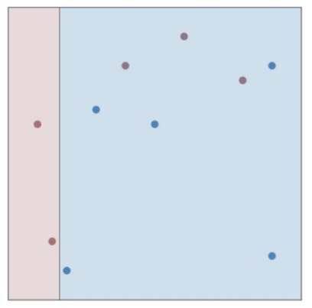
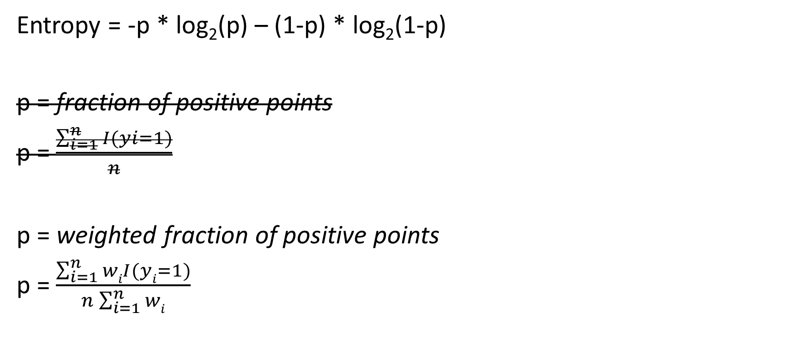
Fitting Classifier
Entropy = -p * log₂(p) – (1-p) * log₂(1-p)
p = fraction of positive points
p = $\frac{\sum_{i=1}^{n}{I(yi=1)}}{n}$
p = weighted fraction of positive points
p = $\frac{\sum_{i=1}^{n}{wiI(yi=1)}}{n\sum_{i=1}^{n}{wi}}$

Slide 22
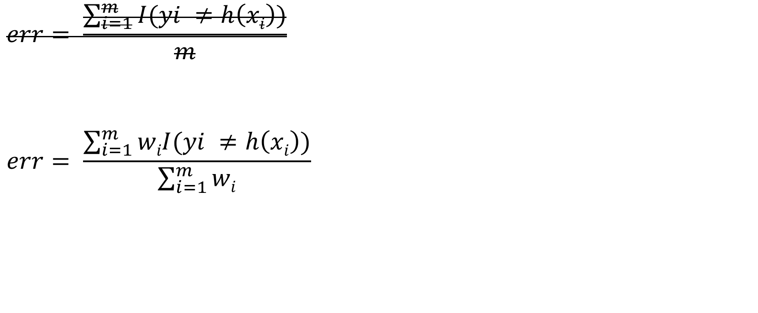
Weights for Individual Classifiers
$$err= \frac{\sum_{i=1}^{m}{I(yi ≠h\left(xi\right))}}{m}$$
$$err= \frac{\sum_{i=1}^{m}{wiI(yi ≠h\left(xi\right))}}{\sum_{i=1}^{m}{wi}}$$

Slide 23
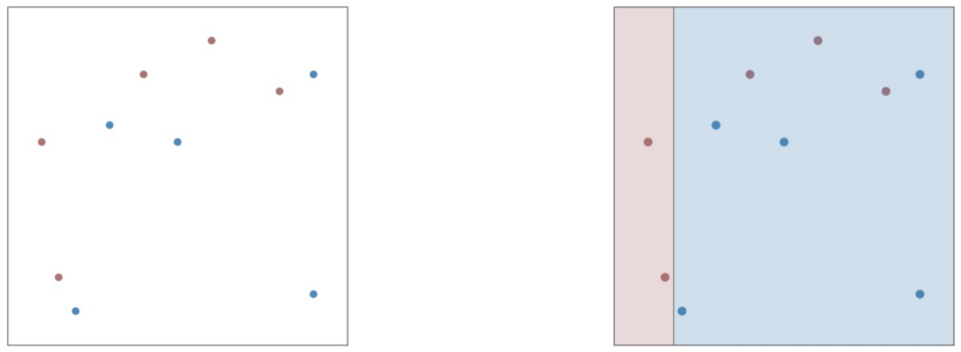

Adaboost – Working Example
First Decision Stump

Slide 24
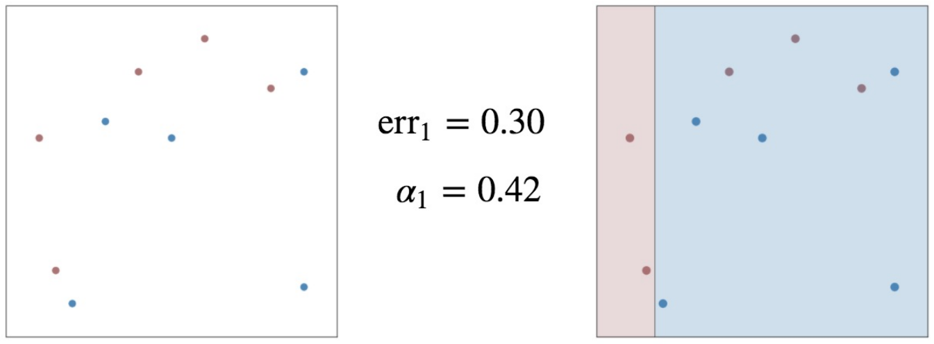

Adaboost – Working Example
First Decision Stump

Slide 25
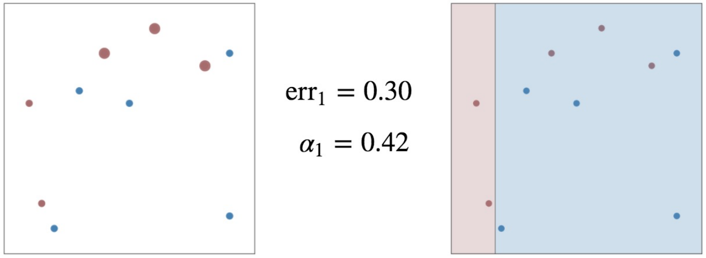
Adaboost – Working Example
First Decision Stump

Slide 26
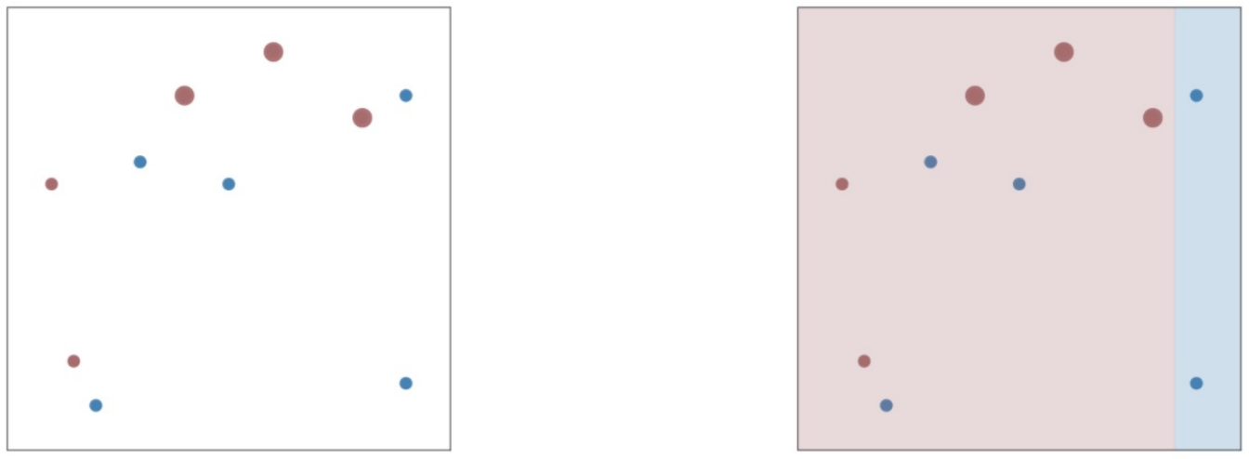

Adaboost – Working Example
Second Decision Stump

Slide 27
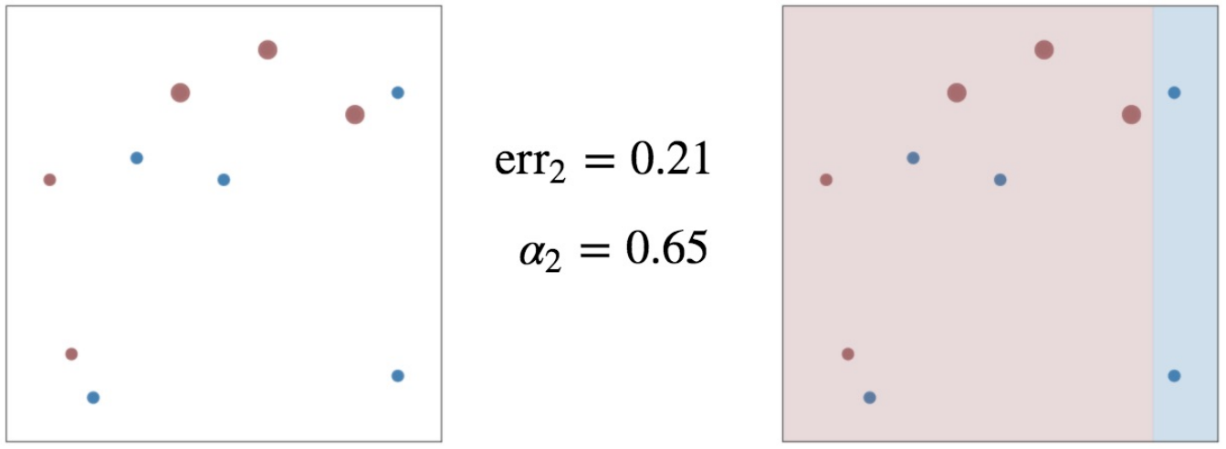

Adaboost – Working Example
Second Decision Stump

Slide 28
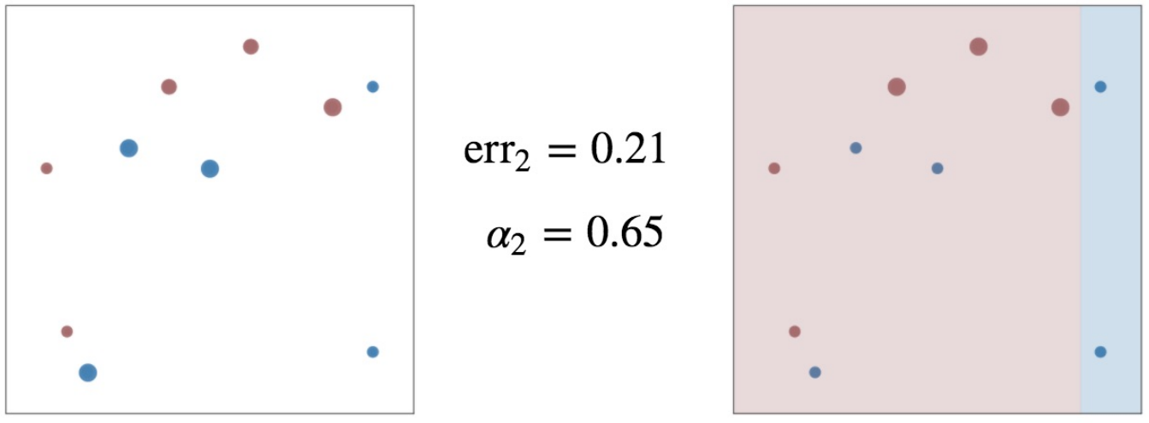
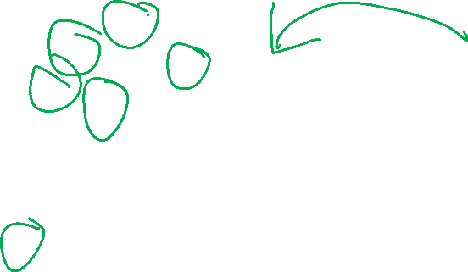
Adaboost – Working Example
Second Decision Stump

Slide 29
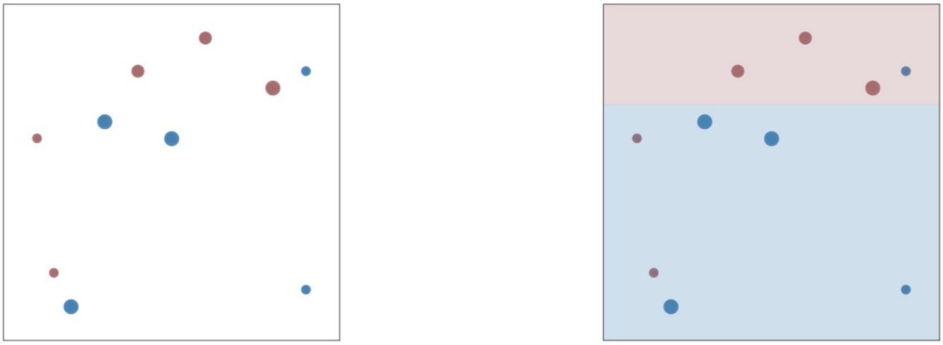

Adaboost – Working Example
Third Decision Stump

Slide 30
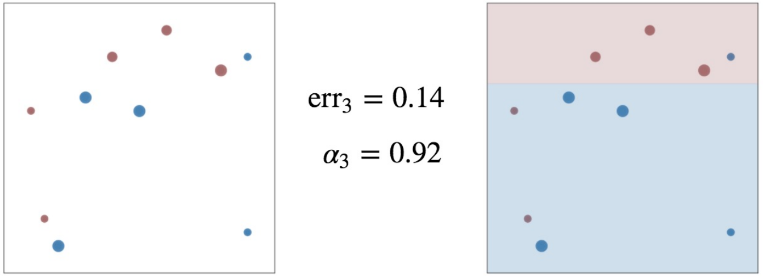
Adaboost – Working Example
Third Decision Stump

Slide 31
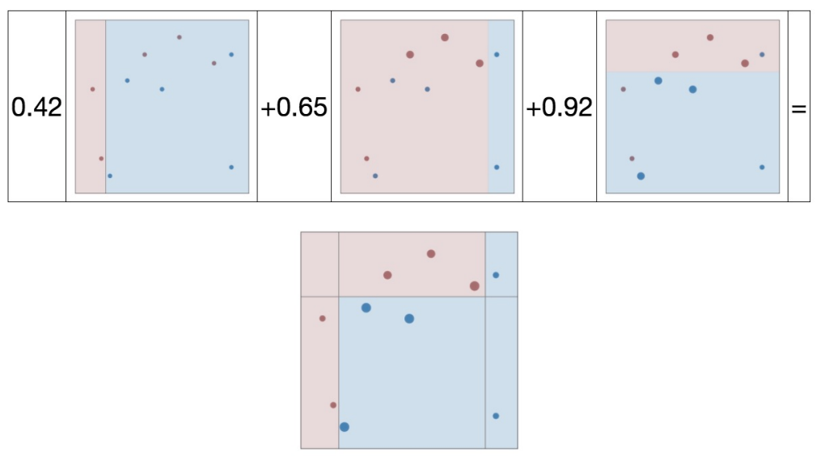
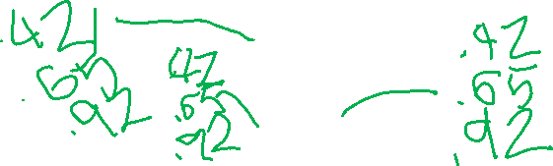
Adaboost – Working Example
Final Ensemble Model

Slide 32
Exam 1 Review Poll
Curse of Dimensionality

Slide 33
Curse of Dimensionality
Features have a value and a cost
- Value: benefit to your training / accuracy
- Cost: Computation time, memory
Time & Effort to collect
If you’re going to include a feature, it better be worth it!
Lots of ways to evaluate / measure the usefulness of a feature…
https://www.kdnuggets.com/2017/04/must-know-curse-dimensionality.html

Slide 34
Gradient Descent – Predicting the weather
We have relevant features (temperature, humidity, wind, latitude, longitude, time of day, day of year…
- say 99 features, across 19,354 “incorporated places” in us
- plus current precipitation
We have sampled data points
- 1 sample per site per minute for 30 years
3.05e+13 features
There are bigger problems out there!
Notes:
https://thumbs.dreamstime.com/z/sun-clouds-rain-snow-storms-14353589.jpg

Slide 35
Generalizing our Optimization – Curse of Dimensionality
Take a 64-feature vector
Transform it using φ(x) = (x_{i}^{T}x_{j})
How many dimensions do I have?
64^2 = 4096

Slide 36
How do we address dimensionality?
A variety of algorithmic considerations
Stochastic Gradient Descent (& Mini Batch)
Kernel Trick
Etc…
Reducing Dimensionality

Slide 37
Exam 1 Review Poll
Interlude: MSE, R^2

Slide 38
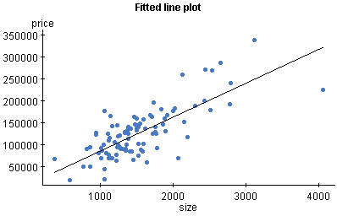
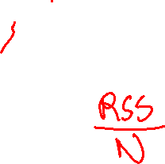
Linear Regression – The Details
First, let’s define “how good” a line is.
- How well does it define our points?
How far away, on average, is each point from the line?
The Mean Squared Error
The difference between each point and the line along the output axis
(square this value to get it to always be a positive value)
Take the mean of this value

Slide 39
Practice Exam 1 Question
Consider a 1D Linear Regression problem, with the following data points:
We set our initial weight w₁ to 2.0 and our bias term w₀ to 1.0. What is the initial Mean Squared Error (MSE)?
x₁ | 1.0 | 2.0 | 3.0 | 4.0 | 5.0
y | 1.0 | 2.0 | 4.0 | 8.0 | 11.0

Slide 40
Practice Exam 1 Question
Consider a 1D Linear Regression problem, with the following data points:
We set our initial weight w₁ to 2.0 and our bias term w₀ to 1.0. What is the initial Mean Squared Error (MSE)?
RSS = ||Y - Xw||^2 / N
(1 - 3)^2 + (2 - 5)^2 + (4 - 7)^2 + (8 - 9)^2 + (11 - 11)^2
4 + 9 + 9 + 1 + 0
23 / 5
x₁ | 1.0 | 2.0 | 3.0 | 4.0 | 5.0
y | 1.0 | 2.0 | 4.0 | 8.0 | 11.0

Slide 41
Developing goodness – alternative view
Yuma weather: sunny = True - 84 % Accuracy
- “There is no variance, assume the average state”
Can we do a similar thing with a regression problem?
House Cost = “There is no variance, assume the average state”

Slide 42

Developing Goodness – a baseline

Slide 43
Developing goodness – coefficient of determination R²
Baseline (Total Sum of Squares) = ||Y–avg(Y)||²
Our Error (Residual Sum of Squares) = ||Y–Xw||²
Improvement: ||Y–Xw||² vs ||Y–avg(Y)||²
R² = 1 – RSS/TSS

Slide 44
Practice Exam 1 Question
Consider a 1D Linear Regression problem, with the following data points:
We set our initial weight w₁ to 2.0 and our bias term w₀ to 1.0. What is the initial R^2 improvement?
x₁ | 1.0 | 2.0 | 3.0 | 4.0 | 5.0
y | 1.0 | 2.0 | 4.0 | 8.0 | 11.0

Slide 45
Practice Exam 1 Question
Consider a 1D Linear Regression problem, with the following data points:
We set our initial weight w₁ to 2.0 and our bias term w₀ to 1.0. What is the initial R^2 improvement?
R^2 = 1 – RSS/TSS
RSS = 23, avg(y) = 5.2
x₁ | 1.0 | 2.0 | 3.0 | 4.0 | 5.0
y | 1.0 | 2.0 | 4.0 | 8.0 | 11.0

Slide 46

Practice Exam 1 Question
Consider a 1D Linear Regression problem, with the following data points:
We set our initial weight w₁ to 2.0 and our bias term w₀ to 1.0. What is the initial R^2 improvement?
R^2 = 1 – RSS/TSS
RSS = 23, avg(y) = 5.2
(1 – 5.2)^2 + (2 – 5.2)^2 + (4 – 5.2)^2 + (8 – 5.2)^2 + (11 – 5.2)^2
70.8
.675…
x₁ | 1.0 | 2.0 | 3.0 | 4.0 | 5.0
y | 1.0 | 2.0 | 4.0 | 8.0 | 11.0

Slide 47
Curse of Dimensionality – Leave-one-out
Train & evaluate your regression model while leaving out one feature at a time.
R^2: .3
Log Sq Ft | # Bedrooms | House Lat. | House Long. | Cost
3.2 | 4 | 121.33 | 47.34 | 500K
3.09 | 3 | 121.33 | 55.23 | 450K
2.87 | 2 | 121.33 | 55.34 | 200K
3.06 | 2 | 130.99 | 47.34 | 1500K

Slide 48
Curse of Dimensionality – Leave-one-out
Train & evaluate your regression model while leaving out one feature at a time.
R^2: .5
Log Sq Ft | # Bedrooms | House Lat. | House Long. | Cost
3.2 | 4 | 121.33 | 47.34 | 500K
3.09 | 3 | 121.33 | 55.23 | 450K
2.87 | 2 | 121.33 | 55.34 | 200K
3.06 | 2 | 130.99 | 47.34 | 1500K

Slide 49
Curse of Dimensionality – Leave-one-out
Train & evaluate your regression model while leaving out one feature at a time.
R^2: .45
Log Sq Ft | # Bedrooms | House Lat. | House Long. | Cost
3.2 | 4 | 121.33 | 47.34 | 500K
3.09 | 3 | 121.33 | 55.23 | 450K
2.87 | 2 | 121.33 | 55.34 | 200K
3.06 | 2 | 130.99 | 47.34 | 1500K

Slide 50
Curse of Dimensionality – Leave-one-out
Train & evaluate your regression model while leaving out one feature at a time.
R^2: .6
Log Sq Ft | # Bedrooms | House Lat. | House Long. | Cost
3.2 | 4 | 121.33 | 47.34 | 500K
3.09 | 3 | 121.33 | 55.23 | 450K
2.87 | 2 | 121.33 | 55.34 | 200K
3.06 | 2 | 130.99 | 47.34 | 1500K

Slide 51
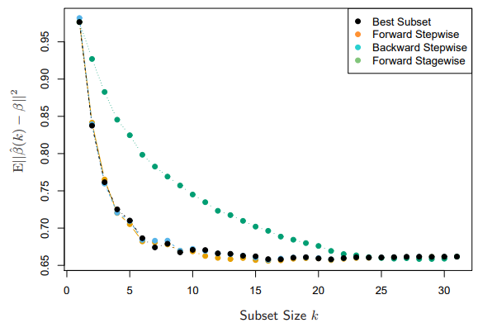

Feature Selection – Stepwise Selection
Forward-stepwise:
Start with an empty model,
add the most predictive
feature, rinse, repeat.
Backward-stepwise:
Start with a full model,
remove the least predictive
feature, rinse, repeat.

Slide 52
Feature Selection – Stagewise Selection
Start with an empty model,
choose the feature that best
correlates to your residual,
update this feature using
the coefficient.

Slide 53
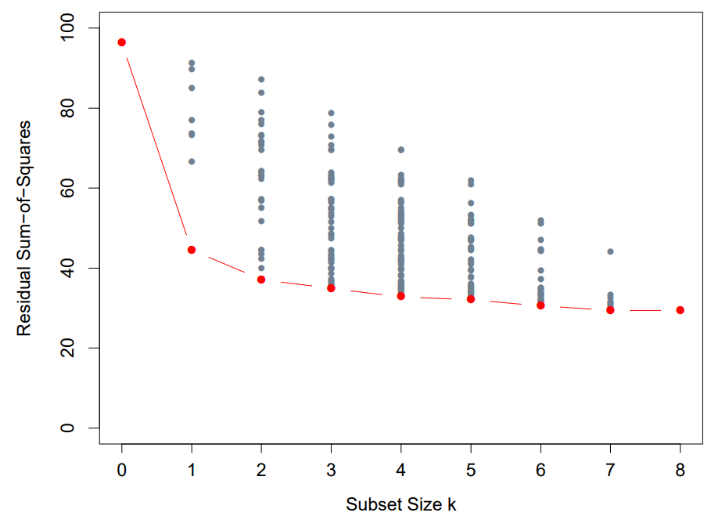

Feature Selection – Best Subset
Choose the k feature set
size you want
Create all subsets of size k
Find the RSS minimization
for your subset

Slide 54
Exam 1 Review Poll
Logistic Regression

Slide 55
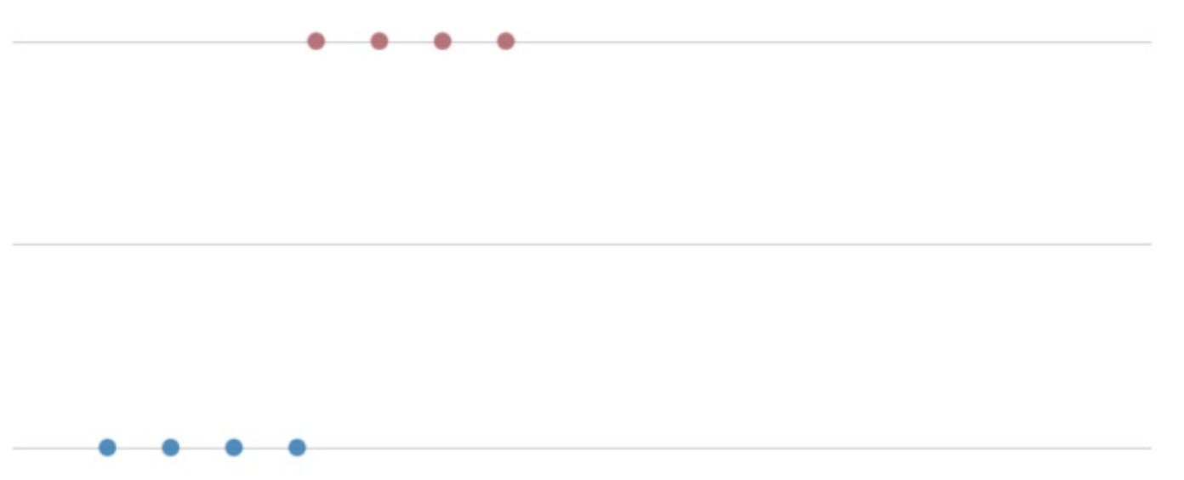

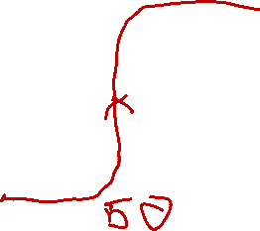
Our Problem Space – Dog Slobber
1 – Dog
0 - ~Dog
Slobber (ml)
Logistic Function
Logistic Function p(X) = 1
1 + e ^{–(w0+w1*X1)}

Slide 56
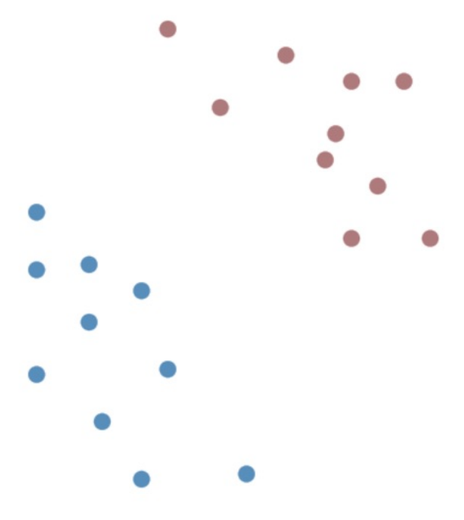
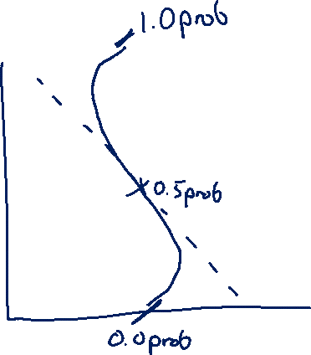
Classifying Points
Logistic Regression
If the Logistic is < .5 it’s one, otherwise the other
Weights to x₁, x₂ to find decision point
Decision boundary is orthogonal to regression line
Logistic Function p(X) = 1
1 + e ^{–(w0+w1*X1 +w2*X2)}

Slide 57
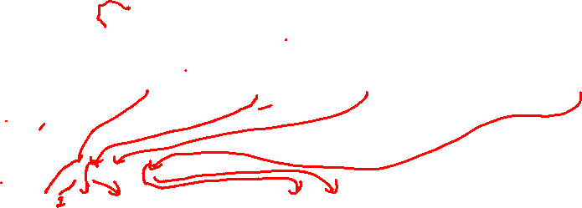
Logistic Regression – Holiday Example
What classification do we give x=[“Santa”, “Bad”]
x = [1, 1, 0, 0, 1, 0]
w₀ + w₁ * x₁ + w₂ * x₂ + w₃ * x₃ + w₄ * x₄ + w₅ * x₅
Feature | Bias | X₁ = “Santa” | X₂ = “Dreidel” | X₃ = “Christmas” | X₃ = “Bad” | X₄ = “Hate”
Weight | -0.1 | 10.0 | 15.0 | 12.0 | -2.0 | -4.0

Slide 58
Logistic Regression – Holiday Example
What classification do we give x=[“Santa”, “Bad”]
x = [1, 1, 0, 0, 1, 0]
w₀ + w₁ * x₁ + w₂ * x₂ + w₃ * x₃ + w₄ * x₄ + w₅ * x₅
-0.1 + 10.0 * 1 + 15.0 * 0 + 12.0 * 0 + -2.0 * 1 + -4.0 * 0 = +7.9
Feature | Bias | X₁ = “Santa” | X₂ = “Dreidel” | X₃ = “Christmas” | X₃ = “Bad” | X₄ = “Hate”
Weight | -0.1 | 10.0 | 15.0 | 12.0 | -2.0 | -4.0

Slide 59

Logistic Regression – Holiday Example
What classification do we give x=[“Santa”, “Bad”]
x = [1, 1, 0, 0, 1, 0]
w₀ + w₁ * x₁ + w₂ * x₂ + w₃ * x₃ + w₄ * x₄ + w₅ * x₅
-0.1 + 10.0 * 1 + 15.0 * 0 + 12.0 * 0 + -2.0 * 1 + -4.0 * 0 = +7.9
1 = 0.999… > 0.5 = Holiday Song!
1 + e ^{–(7.9)}
Feature | Bias | X₁ = “Santa” | X₂ = “Dreidel” | X₃ = “Christmas” | X₃ = “Bad” | X₄ = “Hate”
Weight | -0.1 | 10.0 | 15.0 | 12.0 | -2.0 | -4.0

Slide 60
Logistic Regression – Working with Weights
Feature | Bias | X₁ = “Santa” | X₂ = “Dreidel” | X₃ = “Christmas” | X₃ = “Bad” | X₄ = “Hate”
Weight | -0.1 | 10.0 | 15.0 | 12.0 | -2.0 | -4.0
What sort of relationship do we see from weights and classification?
If the weights & features combination is positive, it’s a positive sample!
If the weights & features combination is negative, it’s a negative sample!

Slide 61
Exam 1 Review Poll
Data Transformations

Slide 62
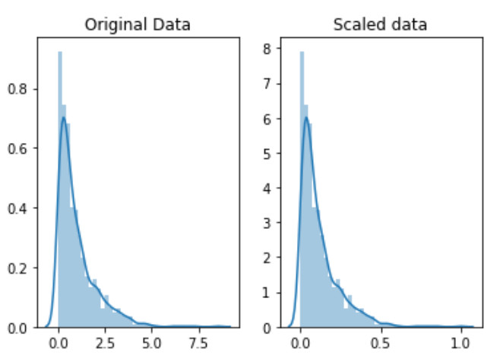
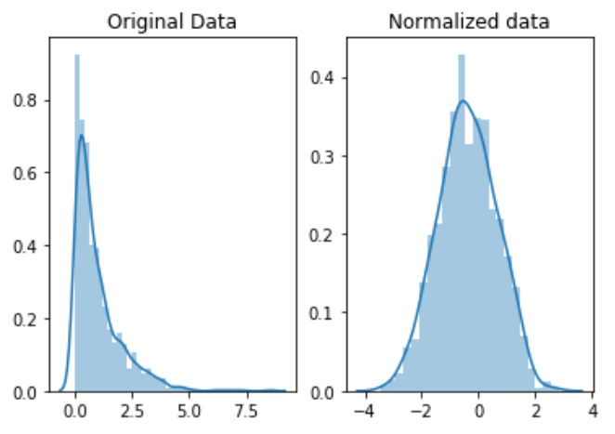
Side² Note: Feature Scaling vs. Normalizing

Slide 63
Min-Max Scaling
Transform X (Data) to X’ (Scaled Data)
For (x_{i}) in X
scale = max(x_{i}) – min(x_{i})
For (x_{i,j}) in (x_{i})
x’_{i,j} = (x_{i,j} – min(x_{i})) / scale

Slide 64
Z-Score Normalization
Transform X (Data) to X’ (Normalized Data)
For (x_{i}) in X
mean = mean(x_{i})
dev = stdev(x_{i})
For (x_{i,j}) in (x_{i})
x’_{i,j} = (x_{i,j} – mean) / dev
https://en.wikipedia.org/wiki/Feature_scaling

Slide 65
Interlude – Types of Data
Continuous Numeric
- Maps to a “real” number
- Distances between numbers have meaning
Discrete Numeric
- Maps to a discrete, infinite set (e.g. integers)
- Distances between numbers have meaning
Ordinal
- Entries have an order, but distances lose meaning
Categorical
- Entries are each unique, but don’t have further restrictions

Slide 66

Problems With Data
Categorical Data

Slide 67
“Categorical” Data – Working with Time
So many representations of time!
- 02/06/2019 3:40PM MST
- 06/02/2019 15:40 MST
- 201906021540
- 2019/06/02 22:40 GMT
- 1549492800
- 1549492800000

Slide 68
Working with Time
Person | Time | Timestamp | Month | Day of Week | Date | Time | isWorking
David | 9/21/2021 3PM | X | 9 | 1 | 21 | 15 | 1
Ayoub | 9/23/2021 3PM | X | 9 | 4 | 23 | 15 | 0
David | 9/25/2021 12PM | X – Y | 9 | 6 | 25 | 12 | 0
David | 9/27/2021 12PM | X – Z | 9 | 1 | 27 | 12 | 1

Slide 69
Numeric Data
City 1 Long. | City 1 Lat. | City 2 Long. | City 2 Lat. | Drivable?
123.24 | 46.71 | 121.33 | 47.34 | Yes
123.24 | 56.91 | 121.33 | 55.23 | Yes
123.24 | 46.71 | 121.33 | 55.34 | No
123.24 | 46.71 | 130.99 | 47.34 | No
-90 | 89.9 | 90 | 89.9 | Yes
179 | -17.7 | -179 | -17.7 | Yes

Slide 70
Text Data
That album was great! I loved it the best out of all my music collection.
Others think it was cool, but I’m tired of Rihanna, I thought the album was bad.

Slide 71
Sequential Data – Past Actions as Features
You could do this forever…
Timestamp | User | N-2Action | PrevAction | Action
100 | David | N/A | Login | Copy
150 | David | Login | Copy | Paste
200 | David | Copy | Paste | Copy
250 | David | Paste | Copy | Paste

Slide 72
Exam 1 Review Poll
Naïve Bayes

Slide 73
Naïve Bayes Classification
We want to model the joint probability: p(x,y)
What we actually care about is the probability of our answer given the data: p(y|x)
p(Y|X) = p(X|Y)*p(Y)
p(X)
Or…
Posterior probability = class-conditional * prior
evidence

Slide 74
Naïve Bayes Classification
“What is the possibility that an example is of class c given its observed features?”
- What is the probability it is a grad (pos) given its HS outcomes?
Given a HS x:
If p(pos | x) >= p(neg | x)
classify as pos
Else
classify as neg

Slide 75
Class-conditional probability p(X | Y)
i.e. “Likelihood”
“Given (or assuming) y = c, what is the probability x is observed?”
“Given my assumptions about failing students, what’s the probability that I see this particular student?”
p(x = [GPA=1.2,SAT=550] | y = neg)
NOTE: Now we’re assuming joint probability of features

Slide 76
Naïve Bayes – Class-Conditional Probability
Features of x are conditionally independent for a given class y.
p(x=[GPA=1.2,SAT=550,ACT=12] | neg) = p(GPA=1.2| neg) * p(SAT=550| neg) * p(ACT=21 | neg)
How do we calculate the class-conditional probability?
Estimate from Data!
P(GPA=1.2| neg) = # failing students with a HS GPA of 1.2
# failing students

Slide 77
Prior Probability p(y)
“What is the probability of encountering class c?”
p(neg) = “What is the probability that any given student will fail?”
How do we get this information?
Estimate it from Data!
P(neg) = # failing students
# students

Slide 78
Evidence p(x)
“The probability of encountering x independent of class”
“the probability of getting that exact message”
We could estimate this using the sum rule…
But it doesn’t actually matter in our decision making process
p(x | pos) * p(pos) >=<? p(x | neg) * p(neg)
p(x) p(x)

Slide 79
Naïve Bayes Classification
p(pos | 1.2, 550, 21) = p(D | pos) * p(- | pos) * p(Low | pos) * p(pos)
 | Pos | Neg | Neg | Neg | Pos | ???
GPA | C | D | D | C | A | D
SAT | + | + | + | + | + | -
ACT | Low | Low | Low | Low | High | Low

Slide 80
Naïve Bayes Classification
p(pos | 1.2, 550, 21) = p(D | pos) * p(- | pos) * p(Low | pos) * p(pos)
Add-1 Smoothing
p(x|y) = p(x,y) + 1 = # positive grads with “x” (found in training) + 1
p(y) +|V| # positive grads (in training) + tot. student options
p(y) = # positive students (found in training) + 1
# students (found in training) + total classes
 | Pos | Neg | Neg | Neg | Pos | ???
GPA | C | D | D | C | A | D
SAT | + | + | + | + | + | -
ACT | Low | Low | Low | Low | High | Low

Slide 81
Naïve Bayes Classification
p(pos | 1.2, 550, 21) = p(D | pos) * p(- | pos) * p(Low | pos) * p(pos)
= 1/7 * 1/4 * 2/4 * 3/7 = 3/392 or 0.0077ish
Add-1 Smoothing
p(x|y) = p(x,y) + 1 = # positive grads with “x” (found in training) + 1
p(y) +|V| # positive grads (in training) + tot. student options
p(y) = # positive students (found in training) + 1
# students (found in training) + total classes
 | Pos | Neg | Neg | Neg | Pos | ???
GPA | C | D | D | C | A | D
SAT | + | + | + | + | + | -
ACT | Low | Low | Low | Low | High | Low

Slide 82
Naïve Bayes Classification
p(neg | 1.2, 550, 21) = p(D | neg) * p(- | neg) * p(Low | neg) * p(neg)
Add-1 Smoothing
p(x|y) = p(x,y) + 1 = # negative grads with “x” (found in training) + 1
p(y) +|V| # negative grads (in training) + tot. student options
p(y) = # negative students (found in training) + 1
# students (found in training) + total classes
 | Pos | Neg | Neg | Neg | Pos | ???
GPA | C | D | D | C | A | D
SAT | + | + | + | + | + | -
ACT | Low | Low | Low | Low | High | Low

Slide 83
Naïve Bayes Classification
p(neg | 1.2, 550, 21) = p(D | neg) * p(- | neg) * p(Low | neg) * p(neg)
= 3/8 * 1/5 * 4/5 * 4/7 = 6/175 or 0.034ish
Add-1 Smoothing
p(x|y) = p(x,y) + 1 = # negative grads with “x” (found in training) + 1
p(y) +|V| # negative grads (in training) + tot. student options
p(y) = # negative students (found in training) + 1
# students (found in training) + total classes
 | Pos | Neg | Neg | Neg | Pos | ???
GPA | C | D | D | C | A | D
SAT | + | + | + | + | + | -
ACT | Low | Low | Low | Low | High | Low

